Slide 1
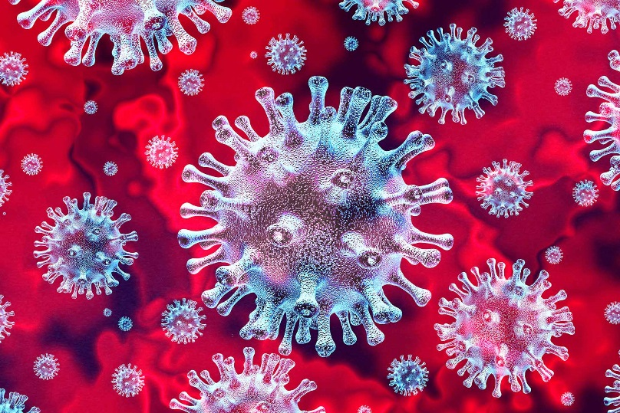
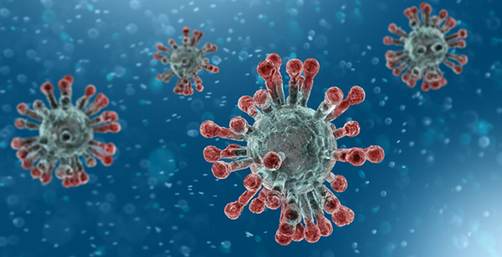
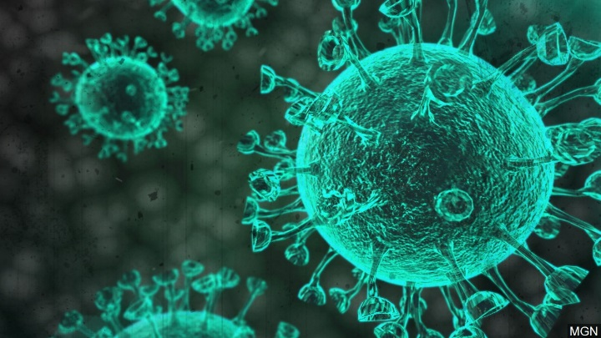
Covid 19 Update
Colin P. Dias, MD
Medical Director
San Fernando Valley Community Mental Health Center

Slide 3
Overview of Discussion
I. Clinical Overview
II. Epidemiology
III. Covid 19 Treatment Options
IV. Status of Vaccine Development
V. Psychological Impact on Society
VI. Discussion/Questions

Slide 4
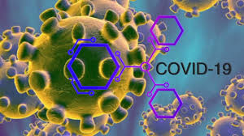
I. Clinical Overview

Slide 5
What is Covid 19?
COVID-19 is a new strain of coronavirus that has not been previously identified in humans. The COVID-19 is the cause of an outbreak of respiratory illness first detected in Wuhan, Hubei province, China.
Coronaviruses are a large family of viruses that are known to cause illness ranging from the common cold to more severe diseases such as Severe Acute Respiratory syndrome (SARS) and Middle East Respiratory Syndrome (MERS).
CDC 2020

Slide 6
Symptoms of Covid 19
Symptoms may appear 2-14 days after exposure:
Cough
Fever
Headache
New loss of taste or smell
Repeated shaking with chills
Sore throat
Shortness of breath
Muscle pain
Runny nose

Slide 7
II. Epidemiology

Slide 8
Total US Cases and Deaths
 | Total Reported | On September 13 | 14-Day Change
Cases | 6.5 Million + | 33,369 | -17%
Deaths | 193,950 | 399 | -18%
NY times, September 14, 2020, CDC

Slide 9
Current U.S. Hotspots
NY times, September 14, 2020, CDC

Slide 10
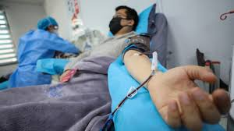
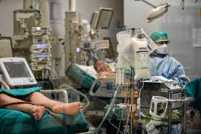
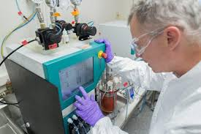
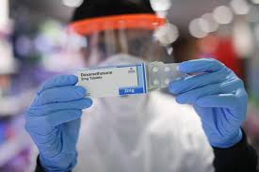
III. Covid 19 Treatment Options

Slide 11
Covid 19 Treatment Options
Blocking the Virus with Antivirals (Remdesivir)
Mimicking the Immune System (Convalescent Plasma)
Reducing Inflammatory Response (Dexamethasone and other Corticosteroids, Cytokine Inhibitors)
Supportive Treatments (Prone Positioning, Ventilators/Respiratory Support, Anticoaggulants)

Slide 12
IV. Status of Vaccine Development

Slide 13
Vaccine Tracker
NY times, September 14, 2020

Slide 14
SARS-CoV-2 VIRUS VACCINE TESTING
Antibody
produced in
response to a
vaccine
SARS-CoV-2
coronavirus
NY times, September 14, 2020

Slide 15
Types of Vaccines
Genetic Vaccines: Vaccines that deliver one or more corona virus genes into our cells to provoke an immune response
Viral Vector: Vaccines contain virus that are engineered to carry coronavirus genes
Protein based: Vaccines contain virus proteins with no genetic material
Inactivated/Attenuate: Vaccines created from weakened/killed virus

Slide 16
Phases of Vaccine Testing
I. PRE CLINICAL TESTING
PHASE I SAFETY TRIALS
PHASE II EXPANDED TRIALS
PHASE III EFFICACY TRIALS
EARLY OR LIMITED APPROVAL
APPROVAL

Slide 17
I. PRECLINICAL TESTING
Scientists test a new vaccine on cells and then give it to animals such as mice or monkeys to see if it produces an immune response. We have confirmed 93 preclinical vaccines in active development.
New York Times, September 14, 2020

Slide 18
PHASE I: SAFETY TRIALS
Scientists give the vaccine to a small number of people to test safety and dosage as well as to confirm that it stimulates the immune system
New York Times, September 14, 2020

Slide 19
PHASE 2: EXPANDED TRIALS
Scientists give the vaccine to hundreds of people split into groups, such as children and the elderly, to see if the vaccine acts differently in them. These trials further test the vaccine’s safety and ability to stimulate the immune system.
New York Times, September 14, 2020

Slide 20
PHASE 3: EFFICACY TRIALS
Scientists give the vaccine to thousands of people and wait to see how many become infected, compared with volunteers who received a placebo. These trials can determine if the vaccine protects against the coronavirus. In June, the F.D.A. said that a coronavirus vaccine would have to protect at least 50% of vaccinated people to be considered effective. In addition, Phase 3 trials are large enough to reveal evidence of relatively rare side effects that might be missed in earlier studies.
NY times, September 14, 2020

Slide 21
EARLY OR LIMITED APPROVAL
China and Russia have approved vaccines without waiting for the results of Phase 3 trials. Experts say the rushed process has serious risks.
New York Times, September 14, 2020

Slide 22
APPROVAL
Regulators in each country review the trial results and decide whether to approve the vaccine or not. During a pandemic, a vaccine may receive emergency use authorization before getting formal approval. Once a vaccine is licensed, researchers continue to monitor people who receive it to make sure it’s safe and effective.
New York Times, September 14, 2020

Slide 23
COMBINED TRIALS
One way to accelerate vaccine development is to combine phases. Some coronavirus vaccines are now in Phase 1/2 trials, for example, in which they are tested for the first time on hundreds of people.
New York Times, September 14, 2020

Slide 24
V. Psychological Impact on Society

Slide 25
Impact of Stress During a Pandemic
Fear and worry about your own health and the health of your loved ones, your financial situation or job, or loss of support services you rely on.
Changes in sleep or eating patterns.
Difficulty sleeping or concentrating.
Worsening of chronic health problems.
Worsening of mental health conditions.
Increased use of tobacco and other substance use disorders
CDC August 2020

Slide 26
Psychological Impact of Covid 19
Psychiatric disorders and suicide in the COVID-19 era , Leo Sher
QJM: An International Journal of Medicine, Volume 113, Issue 8, August 2020, Pages 527–528

Slide 27
Psychological Reactions to Covid-19
Aspecific and uncontrolled fears related to infection
Pervasive anxiety
Frustration and boredom
Disabling loneliness
Psychiatric disorders and suicide in the COVID-19 era , Leo Sher
QJM: An International Journal of Medicine, Volume 113, Issue 8, August 2020, Pages 527–528

Slide 28
RISK FACTORS
Alexithymia
Inadequate supplies
Inadequate information
Psychiatric disorders and suicide in the COVID-19 era , Leo Sher
QJM: An International Journal of Medicine, Volume 113, Issue 8, August 2020, Pages 527–528,

Slide 29
Protective Factors
Resilience
Social support
Preventive strategies
Psychiatric disorders and suicide in the COVID-19 era , Leo Sher
QJM: An International Journal of Medicine, Volume 113, Issue 8, August 2020, Pages 527–528

Slide 32
VI. Where Do We Go From Here?

