Slide 1






Combatting the Mental Health Pandemic with Trauma-Informed Approaches and Self-Care
Christina Giles, LMFT, LPCC, CalWORKs Program Manager
Kim Morrow-Bell, LMFT, CHAT/Bullying and School Violence Advocacy Program
September 15th, 2020
PowerPoint developed by Celida Vasquez, ACSW, Spanish Speaking Mental Health Clinician I

Slide 2

Trauma
Trauma is an event(s):
overwhelms the person’s perceived ability to cope
debilitates her/him through a loss of control
creates the necessity for psychological defenses

Slide 3
Trauma
McCann and Pearlman define trauma as:
An event that is sudden or unexpected
Exceeds the individual’s perceived ability to meet its demands
Disrupts the individual’s frame of reference and other central needs

Slide 4
Types of Trauma
Interpersonal
Accidental
Direct/Indirect
Acute
Chronic & Complex Trauma
Political/Cultural/Systemic
Vicarious

Slide 7

Normalizing Emotions
Strategies that can help
Socializing
  Virtual get-togethers
  Chats and check-ins
  Talk about Non-COVID-19” things
  Play your favorite music
  Nutrition
    New recipes
    take-out and delivery
    Protein
    Healthy Carbs
    Hydrate
It’s okay to feel “off”
It’s okay to feel angry
It’s okay to feel sad
It’s okay to feel distant
It’s NOT okay to do nothing about it!
  Sleep Hygiene
    Limit naps
    Avoid stimulates at bedtime
    Exercise regularly
    Avoid foods that disrupt sleep
    Keep digital devices away
    Establish regular relaxing bedtime routine
    Avoid toxic talk at bedtime

Slide 8
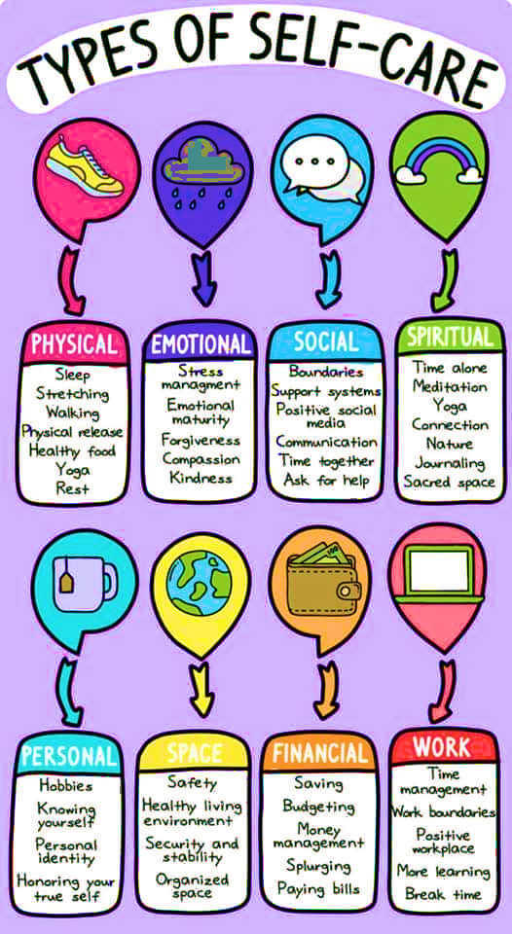

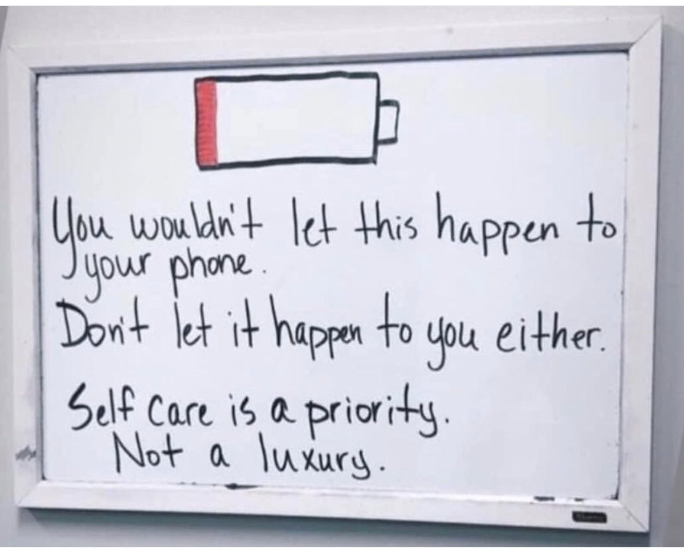
Self Care
SPIRITUAL
SPACE

Slide 9

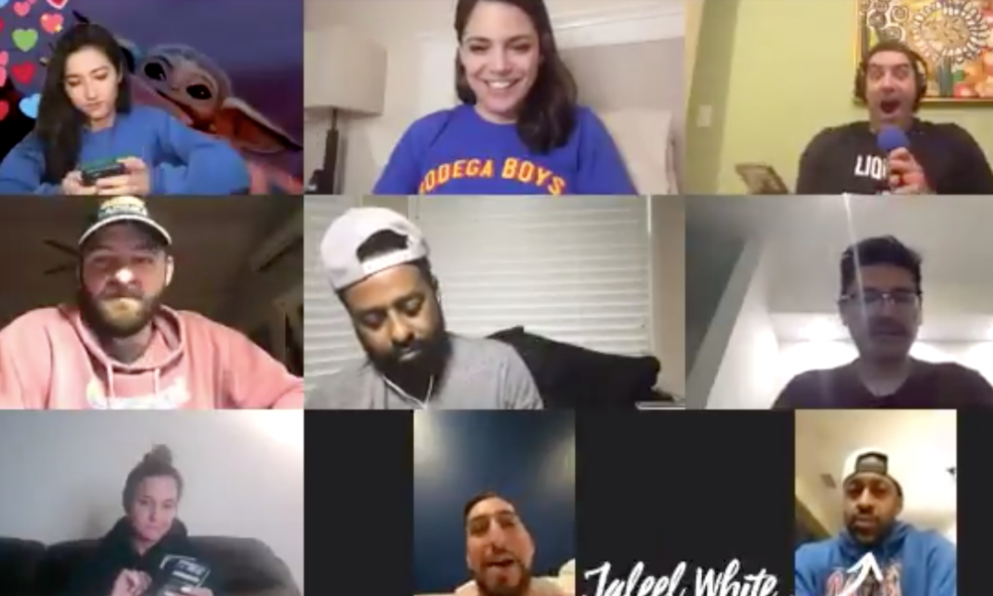
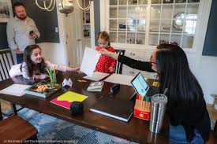
Social Activity
Board games with family
Zoom calls/parties
Movie Watch Party (Netflix, Hulu, etc.)
Book Clubs
Dinner with family

Slide 10
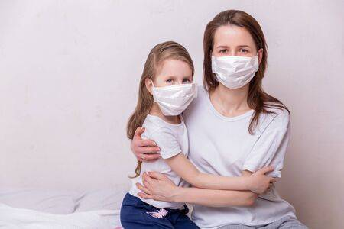
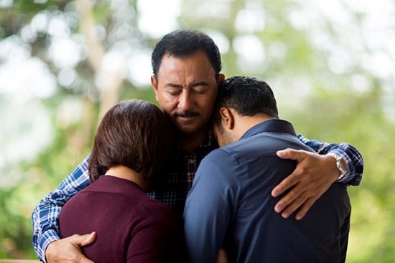
Self Care for Kids
MOVIE NIGHT
GAME NIGHT
Eat breakfast/dinner together
Help them with their homework
Show affection to children – hug/hold hands

Slide 11
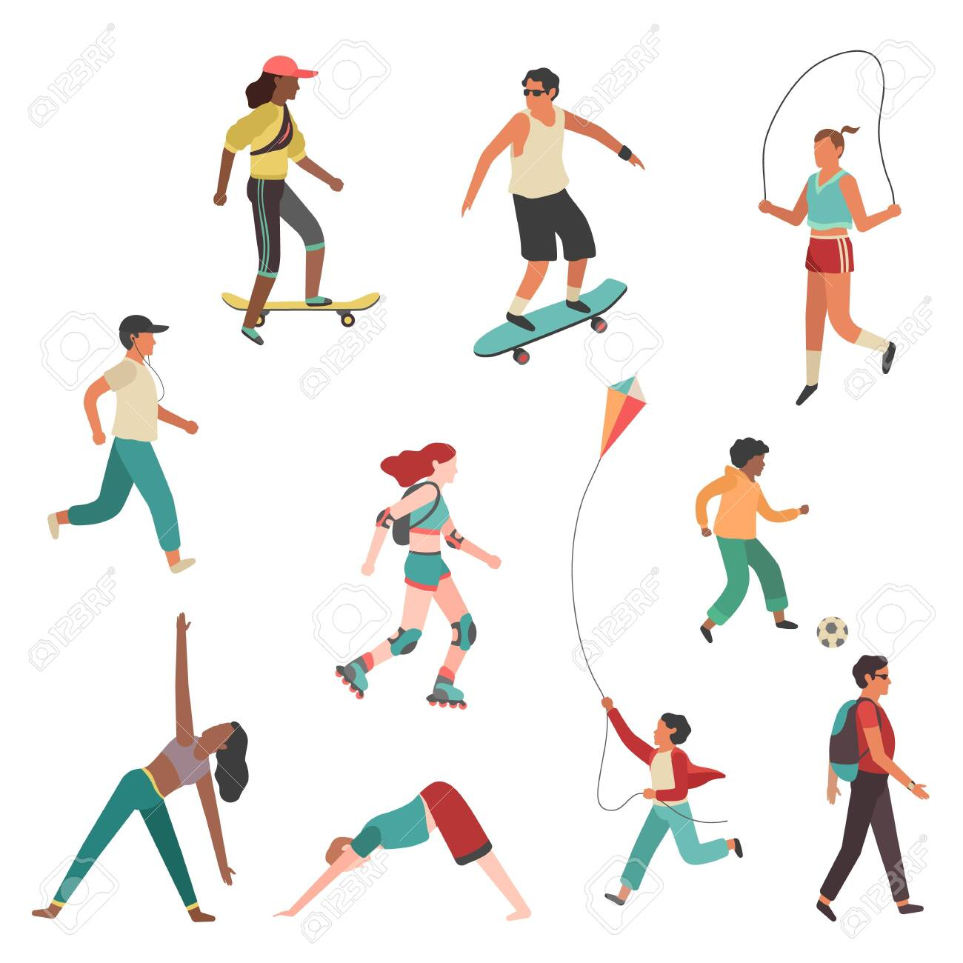
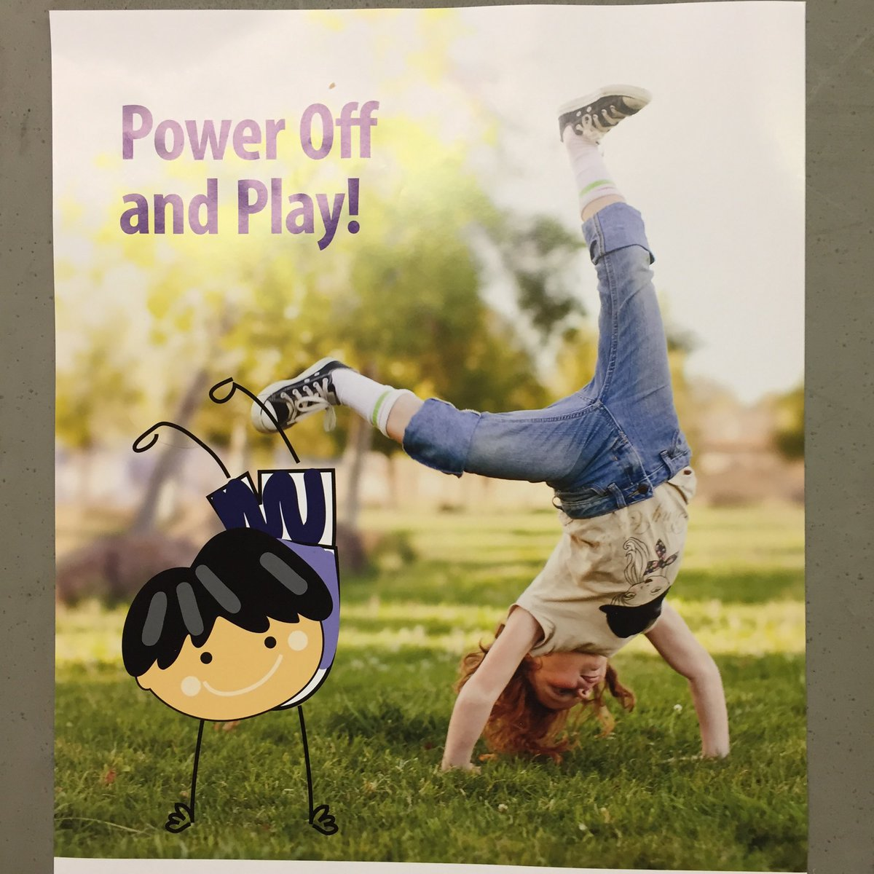
Less TV
Go out for a walk/run
Walk your dog
Exercise at home
Ride a bike

Slide 12
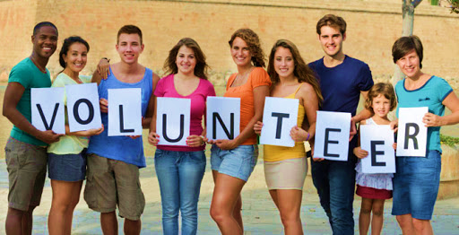
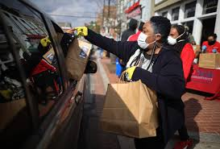
Animal Shelters
Habitat for Humanity
Community Non-Profits
Local Library
LA Works
Food Banks
Homeboy Industries

Slide 13

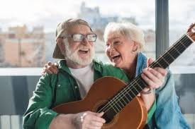
Music/Artistic/Media
Listen to your favorite Album
Listen to a Podcast
Draw/Paint
Learn to play instrument (YouTube)
Audio Books

Slide 14

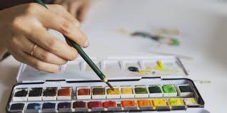
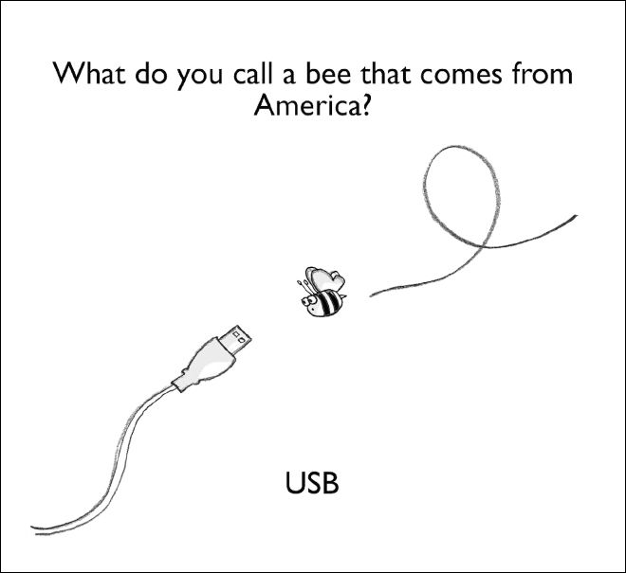
Art
Work
Puzzle
Laugh – joke around
Board Games

