Slide 1
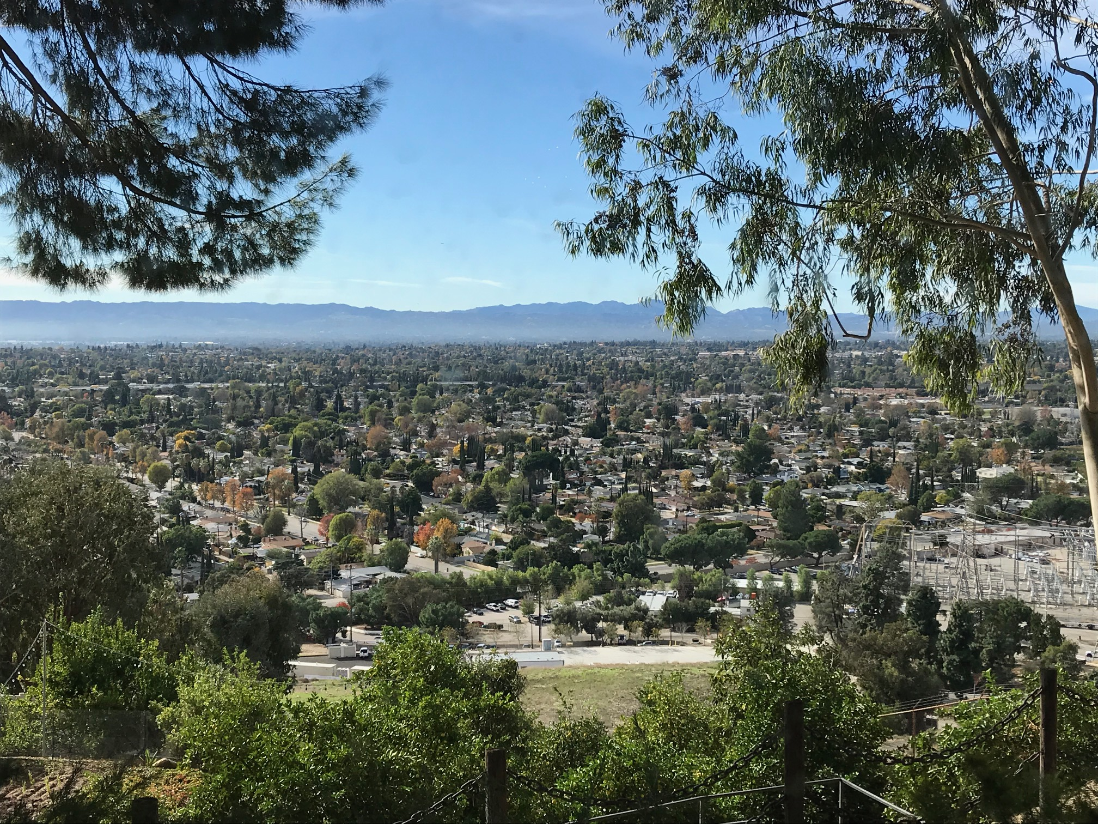
San Fernando Valley Community Mental Health Center, Inc.

Slide 2
Thank you to our event sponsors!
Signature Sponsors:
“Ask the Doctor” Sponsors:
Sofia Ianovskaia
SUTTON ASSOCIATES
Raffle Donors:
Maggiano’s Little Italy & Brent’s Deli
Special thank you to Adam Nettles with Nettles & Associates for web site support for the event.

Slide 3
San Fernando Valley Community Mental Health Center, Inc.
Moving Lives Forward

Slide 4
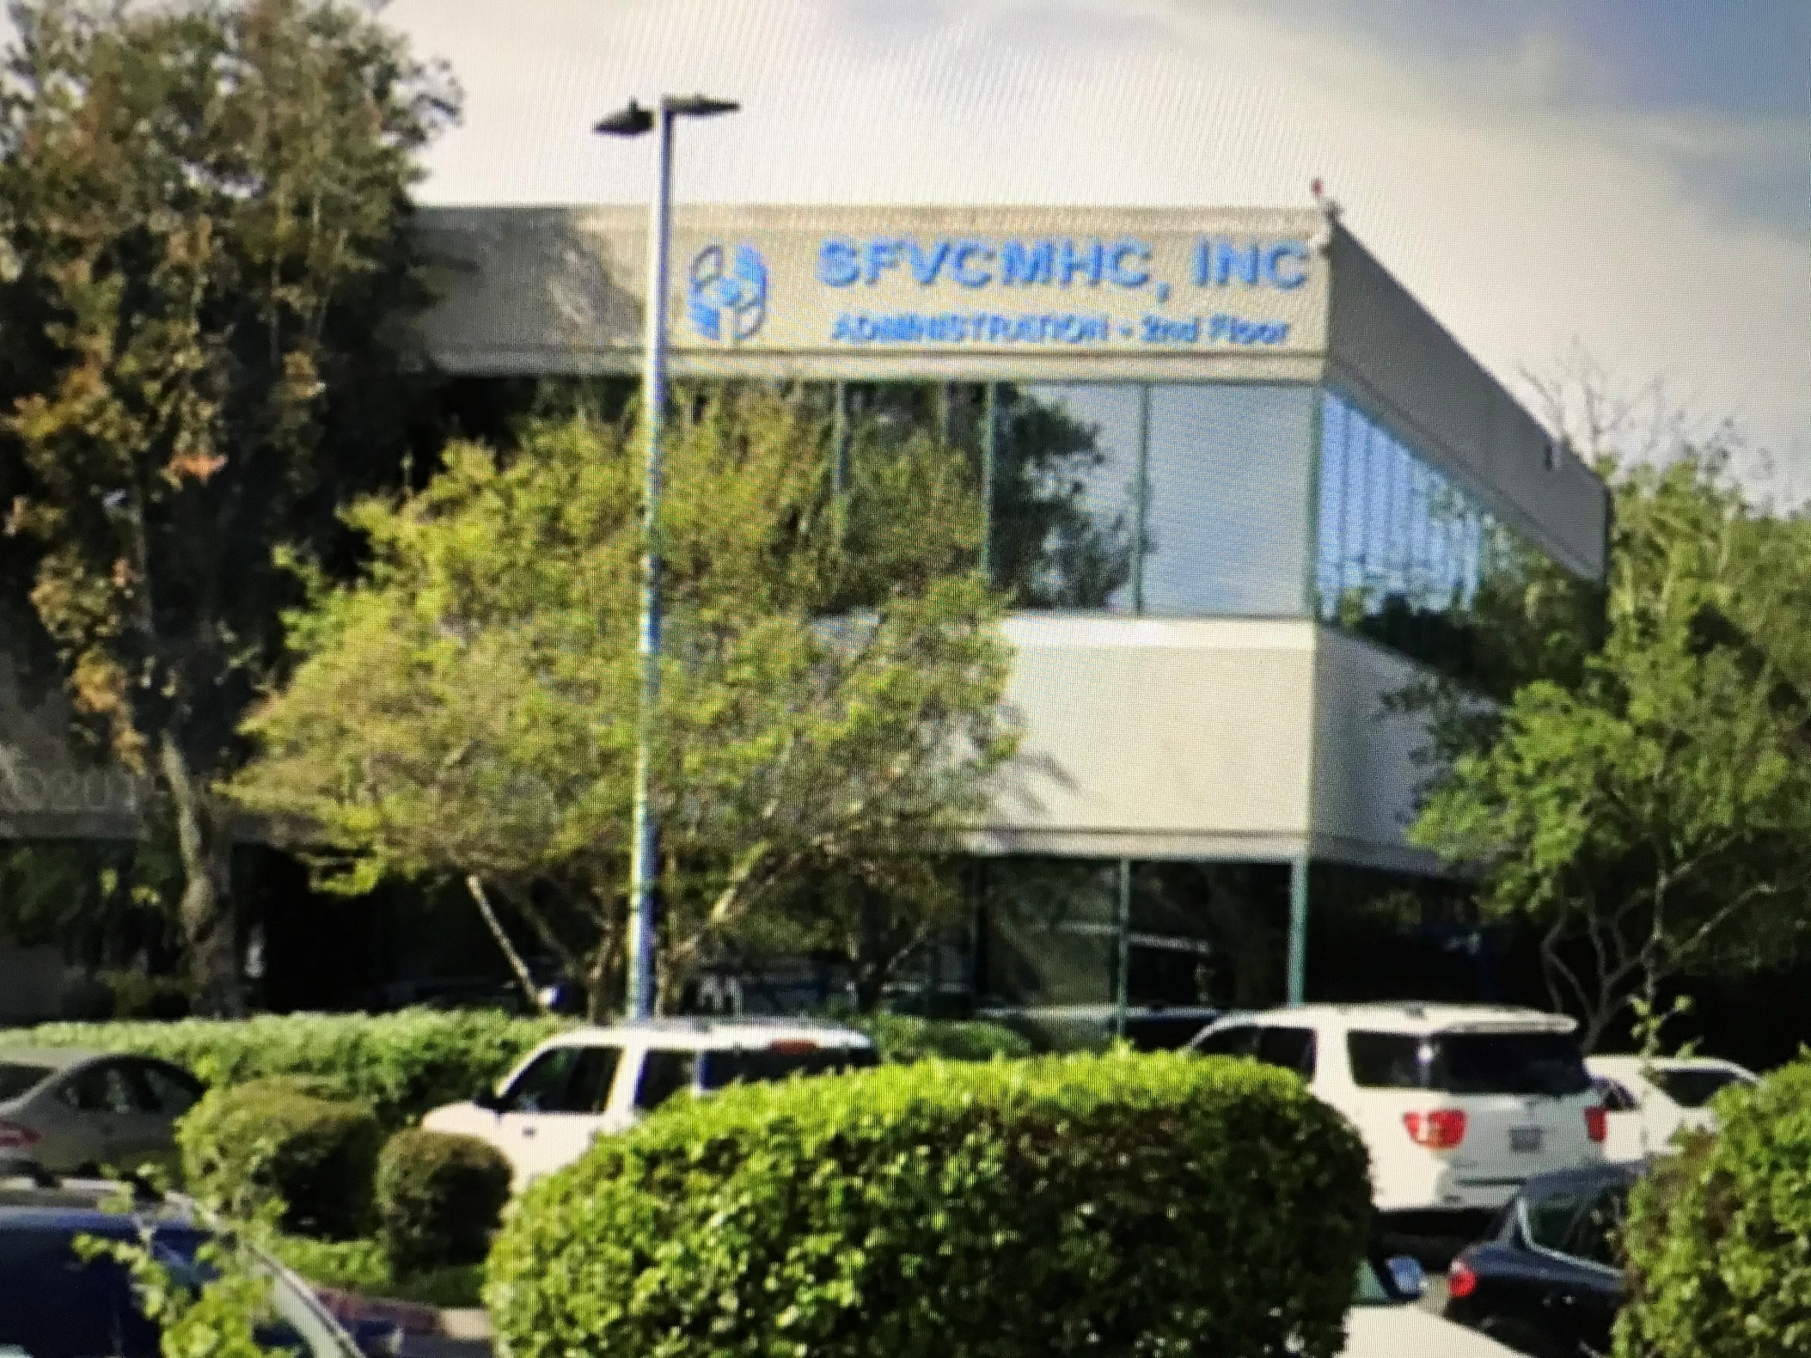

Slide 5
Improving the mental health of individuals and families within the San Fernando Valley.
.
We are keeping families together, protecting individuals from abuse, place the homeless in safe housing, and giving hope to thousands of individuals that a better life is possible.

Slide 6
The Largest Center in the San Fernando Valley!
450 Employees – one of the largest employers in the Valley
Annual Budget of $50 million
49 programs in 15 sites throughout the Valley

Slide 7
Serves individuals of all ages and families
Serves 15,000 Individuals and their families each year
0-5
Children
Transition age youth 18-25
Adults
Older Adults

Slide 8
Center Client Demographics

Slide 9
The clients we’re seeing

Slide 10
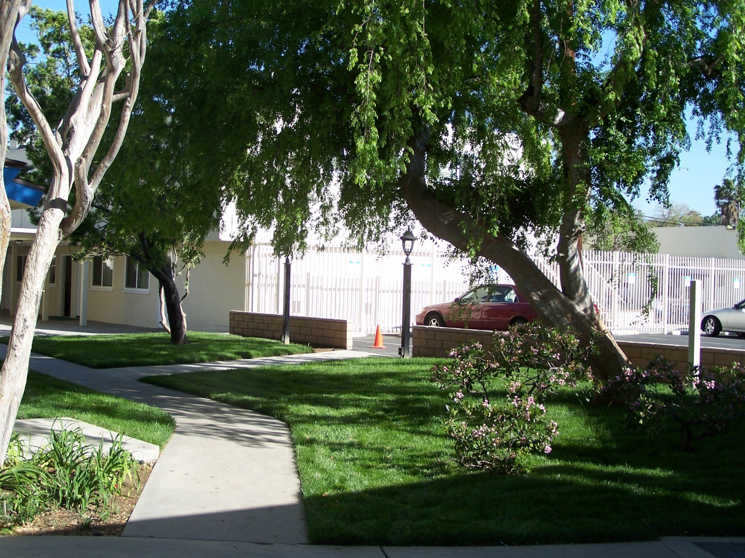
Children’s Services

Slide 11
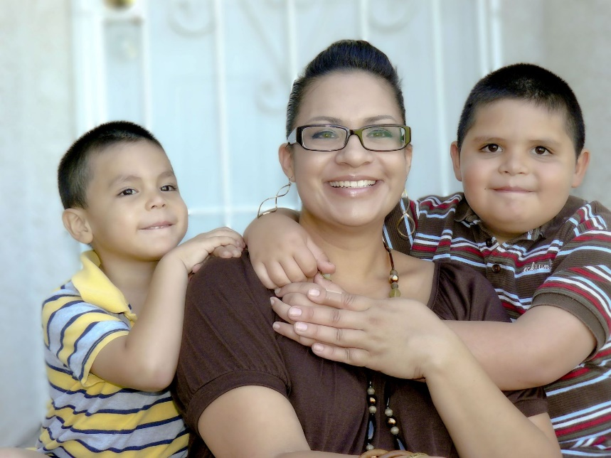
16 Children’s Programs
Treating childhood trauma
Prevention and early intervention
Evidence-based
Strength-based services
Parent skills training
Building resiliency for families
School-based mental health services – in 18 LAUSD Schools
Services in Juvenile Camps
More than 60% of children receiving treatment at the Center are treated for trauma, anxiety, mood disorders, including major depression and bi-polar disorder.

Slide 12
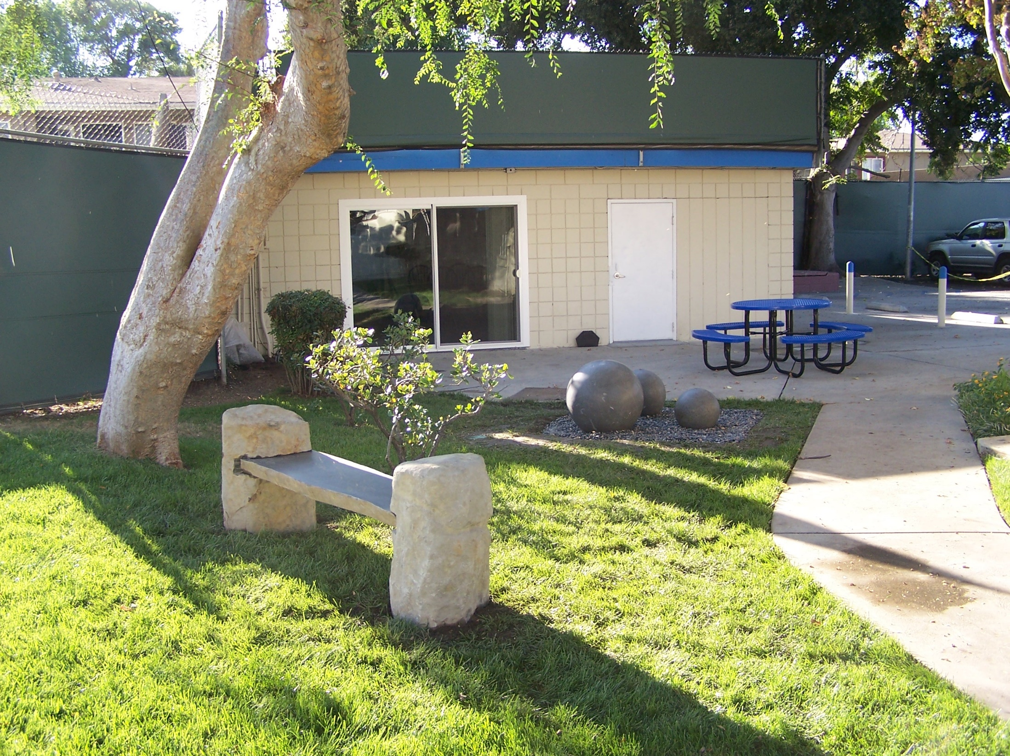
Youth & Family Center

Slide 13
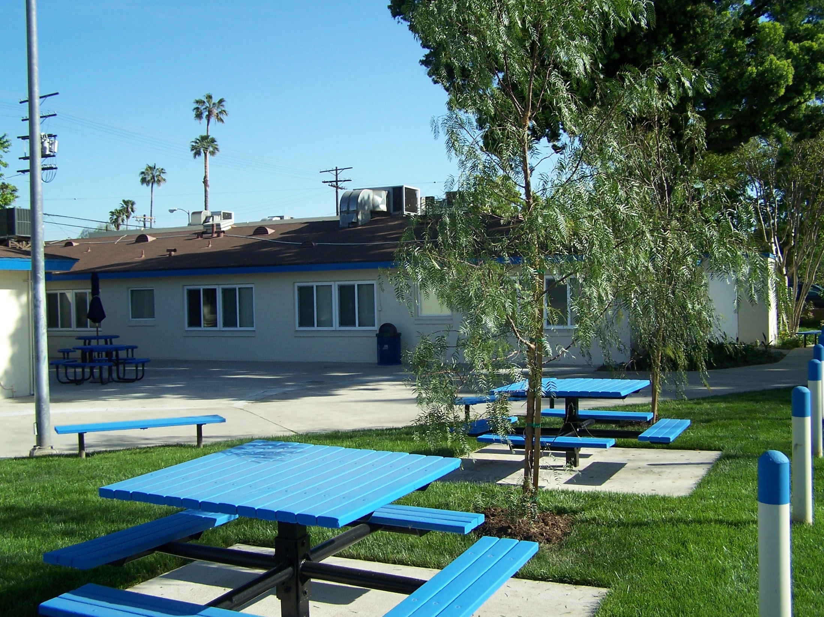
Offering social and educational programs for the entire family.

Slide 14
Holiday parties and games

Slide 15
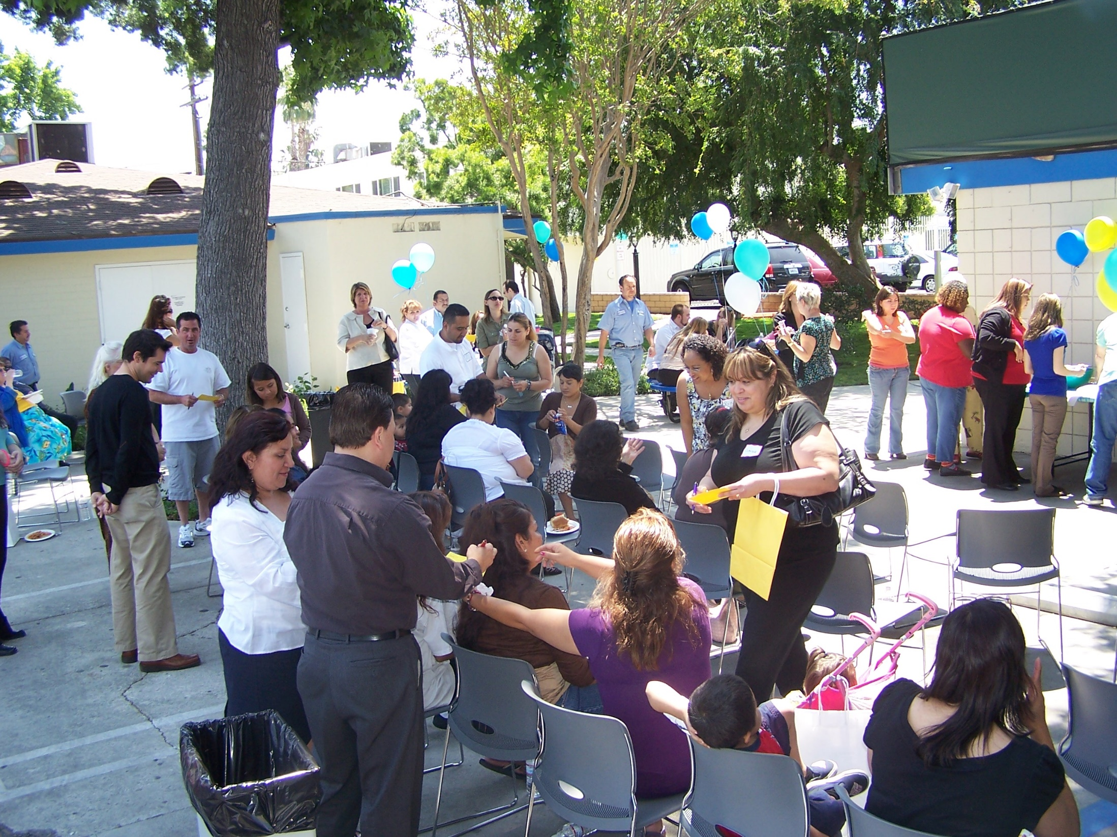

Slide 16
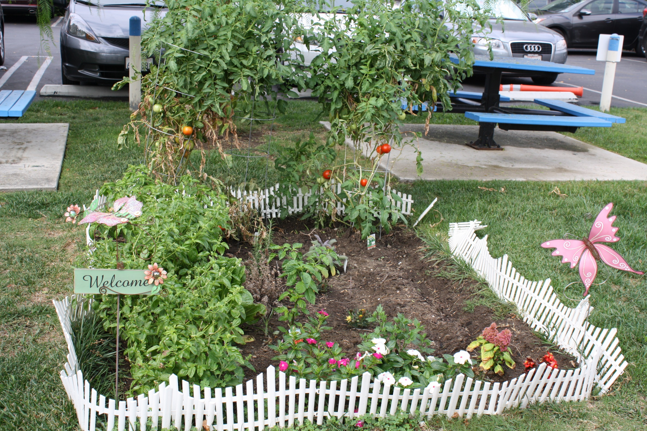
Garden Project
for the families

Slide 17
Annual Toy Drive Provides toys for 1,500 kids

Slide 18
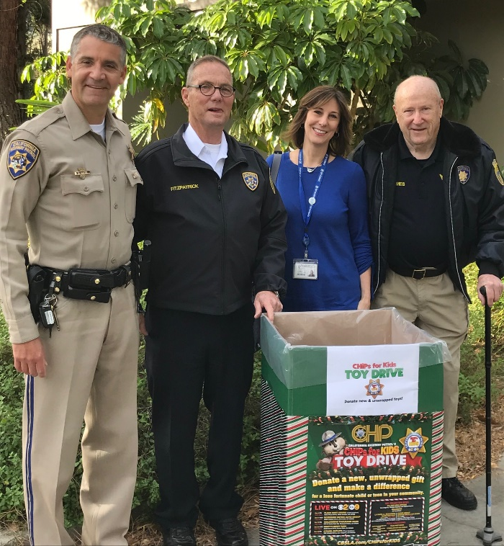
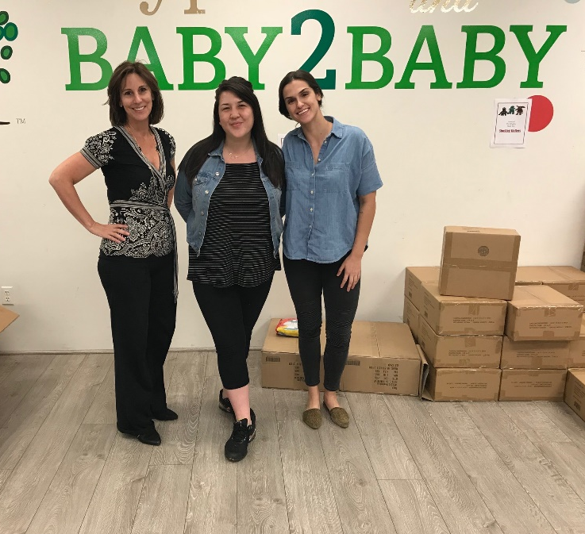
Some of Our Toy Donors: CHiPs for Kids, Motor4Toys, Baby2Baby, Kaiser Labs, Albertson’s, Toys for Tots, MGA, Bell Canyon Association, Julian Berzon, Assemblymember Nazarian, Healthline Medical Group

Slide 19
Our 24/7 Hotline 866-Be-A-Hero

Slide 20
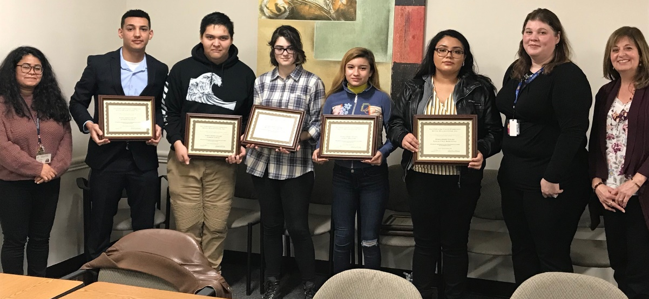
Transition Age Youth 18-25
Prevention services before that first psychotic break
Full range of mental health services including crisis intervention
Substance use counseling
Supported employment training and placement services
The Center provides scholarships to
TAY Youth each year

Slide 21
Adult Services – 20 programs to meet all needs
Center for Family Living and Macdonald Carey Outpatient clinics in Van Nuys and North Hollywood
Client Run Center and Wellness Center
Cornerstone Homeless Services and Access Drop In Center
Transitional Housing
Justice and Diversion Programs
Substance Use Services
Employment Services
Socialization
Housing

Slide 22
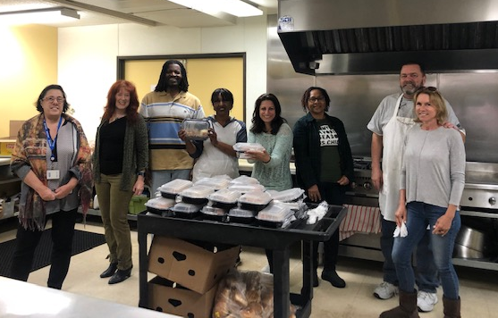
Client Run Center and Victory Wellness Center
Food Bank provides groceries and meals to 500 families each month.
Daily Hot Lunch
Annual Health Fair

Slide 23
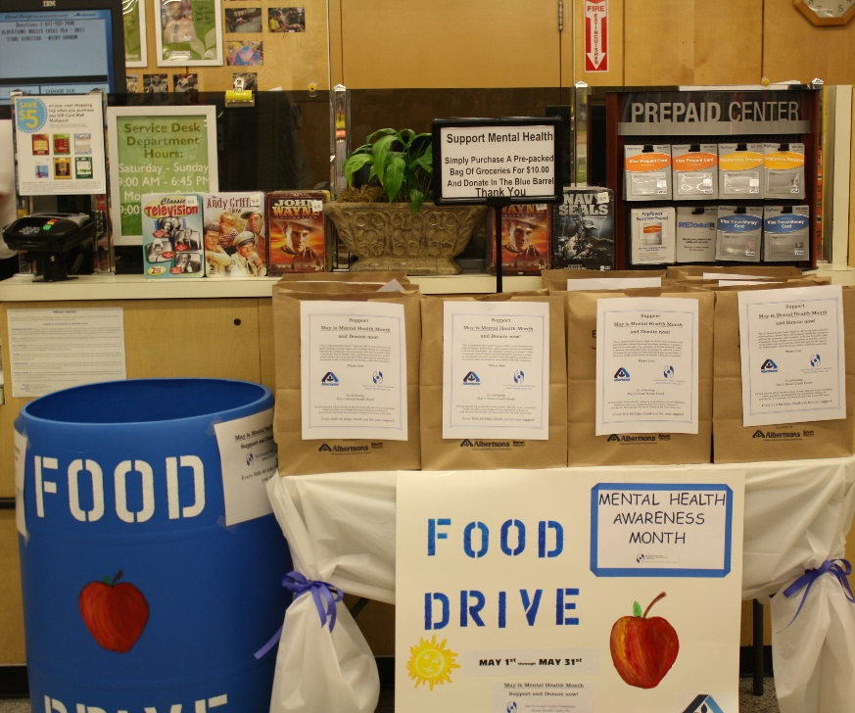
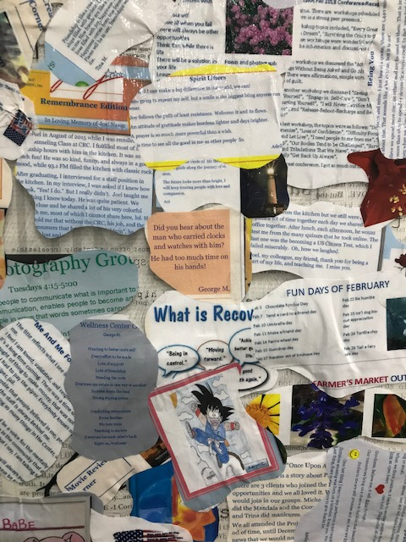
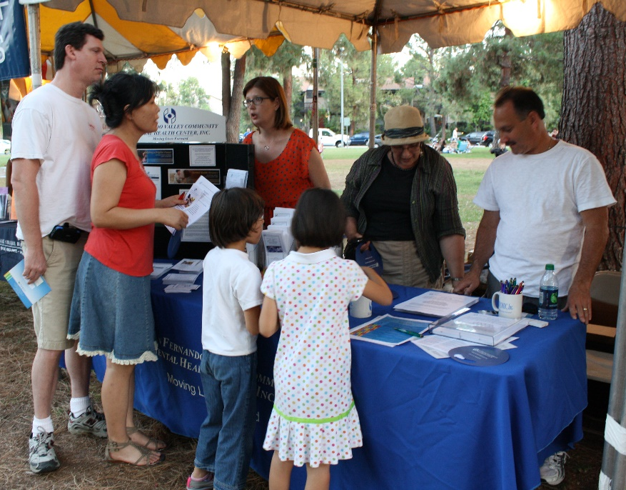
Recognized Countywide for Outstanding
Peer Counseling Training Program

Slide 24
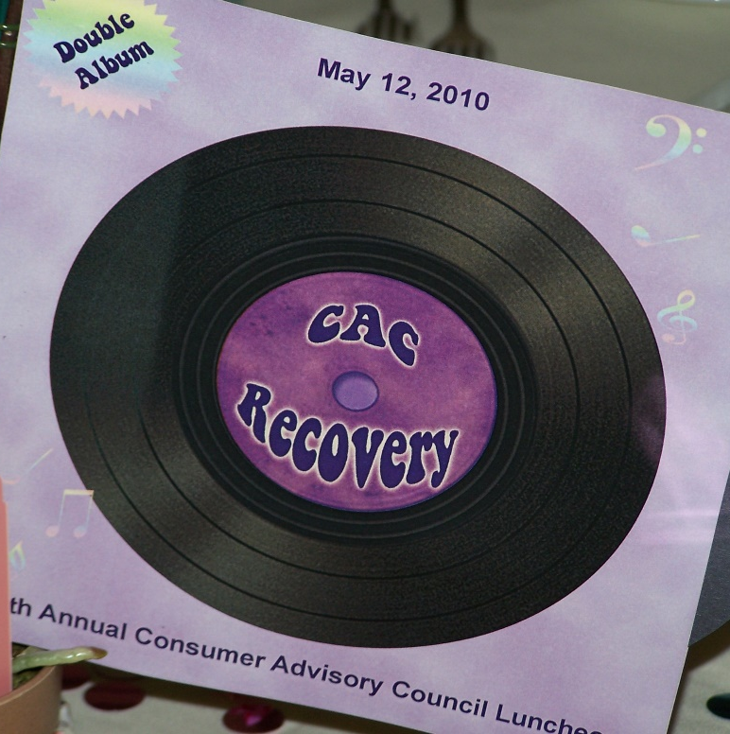
Consumer Advisory Council Clients as a strategic partner to improve services

Slide 25
Homeless Services
From outreach on the streets to housing, the Center offers a full range services to more than 600 homeless individuals each year.

Slide 26
Monty

Slide 27
“For Monty, the key to his success was saying ‘yes’.” Chris, Monty’s therapist
Monty’s Favorite song to play on his accordion.
I close my eyes
Only for a moment and the moment's gone
All my dreams
Pass before my eyes with curiosity
Dust in the wind
All they are is dust in the wind
Kansas
Monty was homeless for 12 years. With the help of compassionate and persistent staff at the Center’s Hamlin Recovery, Resiliency and Re-integration program, he lived in the Center’s Doris Foster Townhomes until he received permanent housing. He is doing well and still receiving supportive services from the Center’s Victory Wellness Center.
“I will never go back to the streets!”
Monty

Slide 28
Services for those involved with the justice system
Counseling in Juvenile Camps
Mental Health, Substance Use counseling services for those diverted from jail or recently released
Housing assistance and navigation
Employment Assistance

Slide 29
Older Adult Services
Ages 55 and older
Prevention and early intervention services
A full range of mental health and substance use counseling
Dealing with anxiety disorders
Helping with housing insecurity
Bringing all of this to our clients in a familiar setting of their choice.

Slide 30
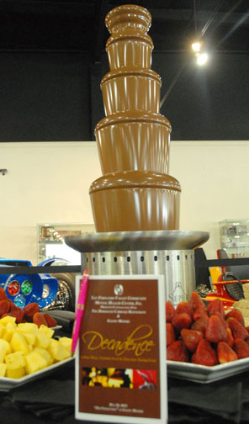
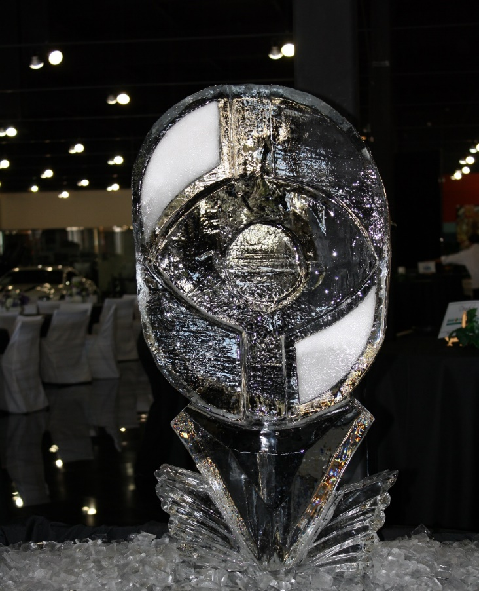
Fundraising/Community Events

Slide 31
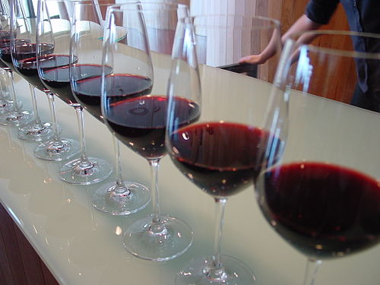
Save the Date for our next fundraiser Thursday, November 12th
Virtual wine tasting, a comedy show featuring Fritz Coleman and more!

Slide 32
You can help too!
www.MovingLivesForward.org

Slide 33
Crushing COVID-19 Keeping mental health from becoming the tsunami after COVID’s earthquake
Featuring:
Dr. Colin P. Dias, M.D.
Medical Director
Kim Morrow-Bell, M.S., LMFT
Program Coordinator
Christina Giles, LMFT, LPCC
Program Manager

